Slide 1
Breast Pathology
Prof. J. Hewavisenthi
Department of Pathology

Slide 2
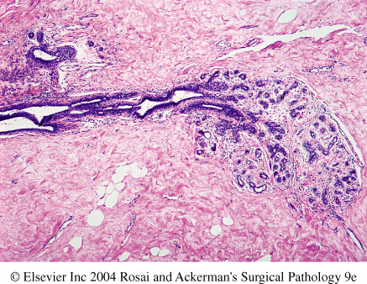
Normal microanatomy of the breast
Modified sweat gland
Lobules containing acini
Terminal ducts
Main branches of the ducts
Lactiferous sinus and nipple

Slide 3
Presentations of breast disease
Lump
Nipple discharge
Pain in the breast - Mastalgia

Slide 4
Breast Pathology
Benign
Inflammatory
Duct ectasia
Fat necrosis
Granulomatous mastitis
Tumour like – Hyperplastic
Fibrocystic disease and other forms of adenosis
Tumour
Fibroadenoma
Phylloides tumour*
Tubular adenoma
Duct adenoma
Nipple adenoma
Papilloma
Malignant
Non – invasive
Duct carcinoma in situ
Lobular carcinoma in situ
Invasive
Duct carcinoma (NST)
Lobular carcinoma
Mucinous carcinoma
Medullary carcinoma
Cribriform carcinoma
Tubular carcinoma
Other malignancies
Metaplastic carcinoma
Lymphoma

Slide 5
Inflammatory conditions
Duct ectasia
Fat necrosis
Granulomatous mastitis and other forms of mastitis (lymphocytic lobular mastitis)
Pregnancy related conditions
  Breast abscess
  Galactocoele
  Lactating / Secretory adenoma

Slide 6
Fat necrosis
Mimics carcinoma because it is a hard irregular mass.
Trauma is the cause.
Oil cysts, collections of foamy histiocytes and multinucleate giant cells similar to fat necrosis in other areas.

Slide 7
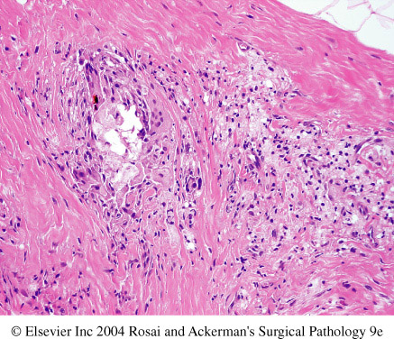
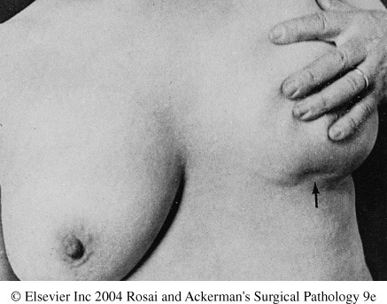
Fat necrosis

Slide 8
Duct ectasia
Segmental involvement of large to intermediate sized ducts
Microscopy
  Dilated ducts
  Periductal fibrosis
  Mononuclear cells surrounding the ducts (mainly plasma cells*)
  Eosinophilic secretory material within the ducts

Slide 9
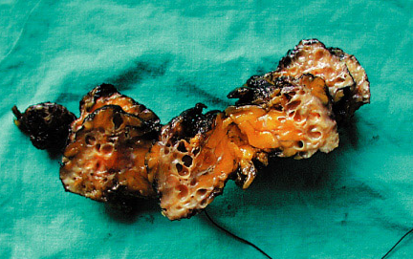
Duct ectasia

Slide 10
Granulomatous mastitis
Specific granulomatous conditions in the breast
  Tuberculosis
  Fungal infections
  Sarcoidosis
Idiopathic granulomatous mastitis
  Granulomatous inflammation centered around the breast lobules
  Autoimmune origin.
  ? Part of the spectrum of duct ectasia – granulomatous mastitis.

Slide 11
Fibrocystic disease of the breast
Fibroadenosis and benign proliferative breast disease are synonyms.
Reproductive period of life – 20 – 40 years
Clinical presentation
  Lumpy or nodular breasts
  Breast discomfort
  Well defined lumps (due to cyst formation)

Slide 12
Fibrocystic disease of the breast
Cyst formation
  Blue domed cyst of Bloodgood
Epithelial hyperplasia
Various forms of adenosis
  Sclerosing adenosis
  Blunt duct adenosis / Columnar alteration of lobules
  Apocrine adenosis
Apocrine metaplasia
Fibrosis – mainly perilobular

Slide 13
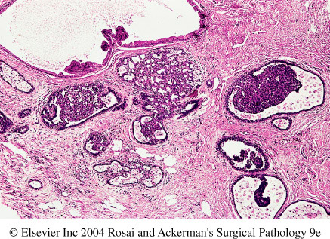
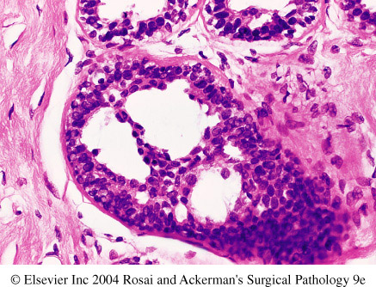
Cyst formation, epithelial hyperplasia fibrosis
Florid epithelial hyperplasia

Slide 14
Fibroadenoma
Commonest benign lesion in the breast
Young women – 15 – 30 years
Macroscopy
  firm white with slightly myxoid appearance
Microscopy
  Proliferation of stroma
    Fibrohyaline
    Cellular
    Fibromyxoid
    Myxoid
  Proliferation of glands
    Elongated compressed bilayered glands

Slide 15
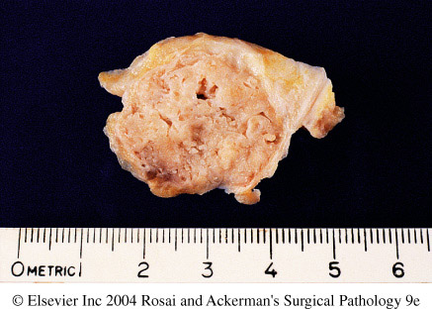
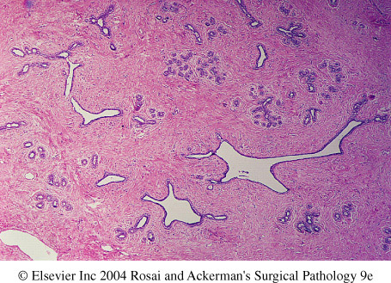

Slide 16
Phylloides tumour
30 - 70 years of age
Benign, boderline and malignant varieties
Macroscopy
  Large fibroadenoma
  10 -15 cm in size
  Grey - white with cystic cavities.
Microscopy
  hypercellular stroma* (Cf: Fibroadenoma)
  compressed benign ducts

Slide 17
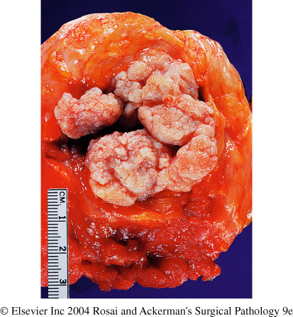
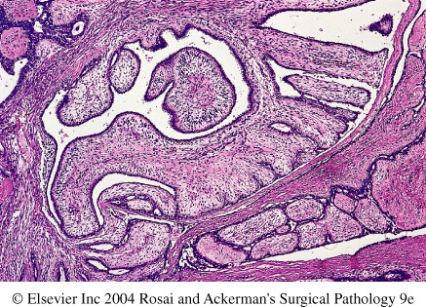
Macroscopy & Microscopy -
note the leaf like appearance

Slide 18
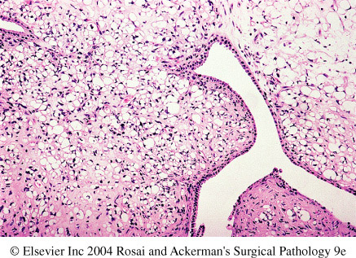
Malignant Phylloides tumour - note the hypercellular pleomorphic stroma

Slide 19
Duct papilloma
3rd - 4th decades of life
produces a serosanguinous nipple discharge
Macroscopy
  < 1.0cm and close to the nipple
  Rarely peripheral - duct papillomatosis
Microscopy
  Papillary structures
  DD - Papillary carcinoma of the breast

Slide 20
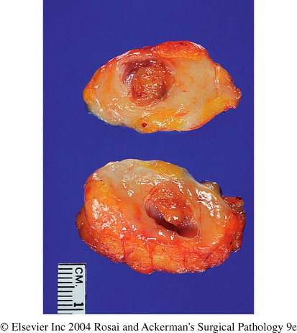
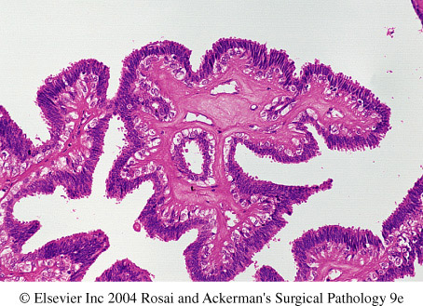

Slide 21
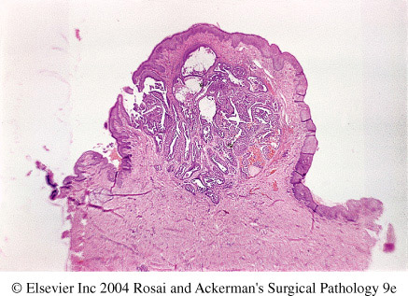
Other types of adenomata
Nipple adenoma
Duct adenoma
Lactating adenoma
Tubular adenoma

Slide 22
Carcinoma of the breast
One of the commonest human malignancies
  25% of all female cancers in USA
  20% of cancer deaths amongst females in USA.
Highest in the perimenopausal age group
  Uncommon under the age of 25 years

Slide 23
Aetiology
Geography
  Commoner in developed countries (excluding Japan) - ? Related to dietary factors
Genetic factors
  Family history
    first degree relatives (mother, sister, daughter) with breast cancer increases risk - x 5 -6 times
    number of blood relatives
    bilateral cancers
    high risk of cancer families - ovarian, endometrial and colorectal

Slide 24
Aetiology
Genetic factors contd
  Mutations
    BRAC1 and BRAC2 genes (chromosome 17 & 13)
    P53 (associated with Li Fraumenni Syndrome)
    PTEN (phosphate and tensin tumour supressor gene)

Slide 25
Aetiology
Oestrogen excess
  Women with prolonged reproductive life
  Unmarried, nulliparous women
  Lactation reduces risk.
  Women with first childbirth over the age of 30
  Functioning ovarian tumours
  Oestrogen replacement therapy following menopause (not in balanced preparations)

Slide 26
Aetiology
Environmental and dietary factors
  Large amounts of animal fat
  Cigarette smoking
  High calorie food
  Alcohol
Fibrocystic disease
  with florid epithelial hyperplasia
  with atypical epithelial hyperplasia

Slide 27
Clinical features
Breast lump
  Hard - firm
  Irregular margins
  Nipple retraction
  Fixed to deeper structures or skin (lack of mobility)
  Peu d’orange appearance
  Breast shield (Carcinoma en cuirasse)
Nipple discharge

Slide 28
Pathology
Non – invasive
  Duct carcinoma in situ
  Lobular carcinoma in situ
Invasive
  Duct carcinoma (NST)
    Duct carcinoma - Special types
    Mucinous carcinoma
    Medullary carcinoma
    Cribriform carcinoma
  Lobular carcinoma

Slide 29
Intraduct carcinoma
Gross
  poorly defined mass
  cystically dilated ducts containing cheesy material - comedo pattern
  polypoidal / friable mass
Microscopy
  Proliferating epithelial cells within the duct lumina
  4 patterns - solid, comedo, papillary, cribriform

Slide 30
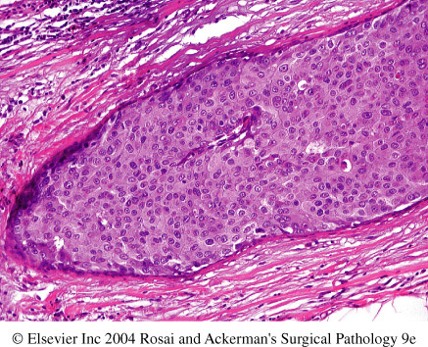
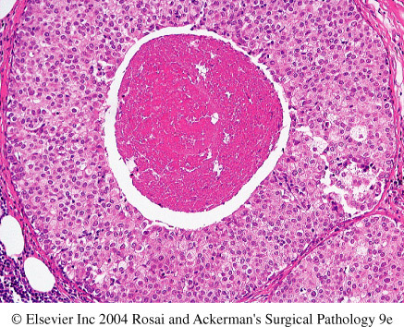
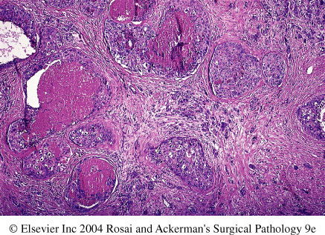

Slide 31
Intralobular carcinoma (Lobular carcinoma in - situ)
Not a palpable lesion
Tends to be bilateral
Microscopy
  Filling up of the terminal ducts and acini by uniform loosely cohesive cells.

Slide 32
Invasive carcinoma
Gross
  Irregular margins
  Hard cartilage like mass
  Cuts with a gritty feel (Cutting a pear)
  Grey-white to yellowish in colour
Microscopy
  Duct carcinoma
  Lobular carcinoma
  Duct carcinoma (Special types)

Slide 33
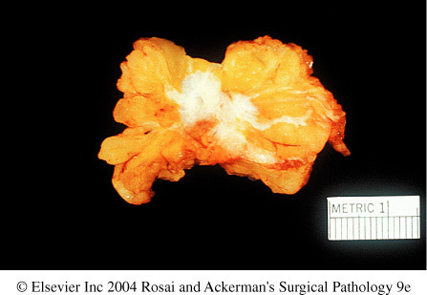
Gross appearance of breast carcinoma - note irregular margins
cf: Fibroadenoma

Slide 34
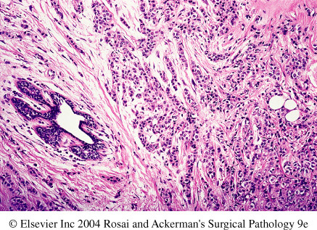
Duct carcinoma - No special type (NST)

Slide 35
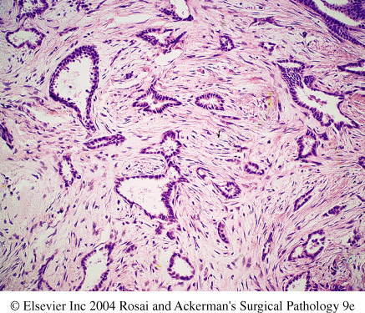
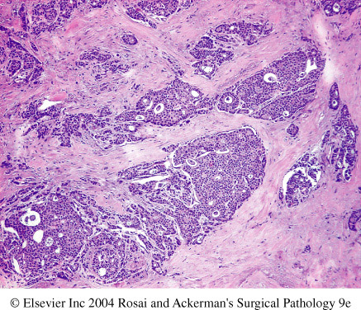
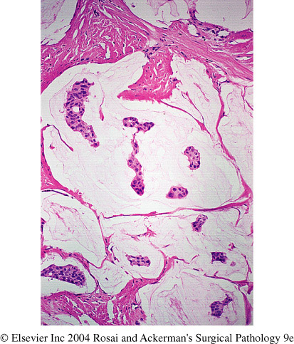

Slide 36
Prognostic indicators in Breast carcinoma
Routine histopathology criteria
  Tumour size
  Histological type
  Histological grading (Nottingham grading)
    Mitotic activity
    Tubule formation
    Nuclear pleomorphism
  Axillary and nodal status
  Vascular and lymphatic invasion
  others

Slide 37
Prognostic indicators in Breast carcinoma
Routine histopathology criteria contd.
  others
    Tumour circumscription
    Inflammatory reaction
    Stromal elastosis
    Intraduct component
    Skin involvement

Slide 38
Prognostic indicators in Breast carcinoma
Hormone receptor status
  ER PR positive - good response to treatment
  HER 2 NEU (C-ERBB2) - underexpression favourable
Biological indicators
  Mitotic activity
  Favourable indicators :
    Epidermal growth factor underexpression
    Angiogenesis low ( VEGF,CD31, CD34)
    Oncogene dysregulation - BRCA negative, TP53 positive, BCL2 positive, Cathepsin D negative

Slide 39
Assignment
What are the causes for
  Nipple discharge
  Breast lump
  Mastalgia
What are the conditions that mimic breast carcinoma ?
Explain the pathological basis of the various clinical features of breast carcinoma

